Slide 1
Fitting time series models, Part 2
CIHR Course Week 3
Isabel (Izzie) Fulcher
isabel_fulcher@hms.harvard.edu

Slide 2
Goals of this course - today
The specific objectives are:
To identify indicators most relevant for these purposes.
To describe and interpret the models used to a) establish a baseline; b) assess higher or lower levels than expected during the pandemic.
To understand the data processing pipeline - from receipt of indicator data to production of figures.
To interpret results from the various visualizations of the data and results.
To be able to implement the data cleaning, modeling and visualization process in R.

Slide 3
Teaching Objectives
Recap of time series modeling from Part 1
Syndromic surveillance
Motivation
Steps
Group activity
Prediction intervals

Slide 4
Time Series Part 1 Recap

Slide 5
Research questions with time series data
Describe the behavior of an indicator over time
Is infant mortality decreasing over time? By how much?
What are the seasonal differences in malaria cases?
Detect deviations from expected in an indicator
Is a region experiencing higher than expected cases of diarrhea?
Is the number of health facility deliveries lower than expected?
Measure the impact of an intervention on an indicator
After social distancing measures were put in place, how many fewer COVID-19 cases were there?
Notes:
What have we done so far?

Slide 7
outcome_{t} =β₀+ε_{t}
intercept only model

Slide 8
outcome_{t} =β₀+ β₁·time+ε_{t}
intercept and slope model

Slide 9
outcome_{t} =β₀+ β₁·time+β₂·time²+ε_{t}
quadratic model

Slide 10
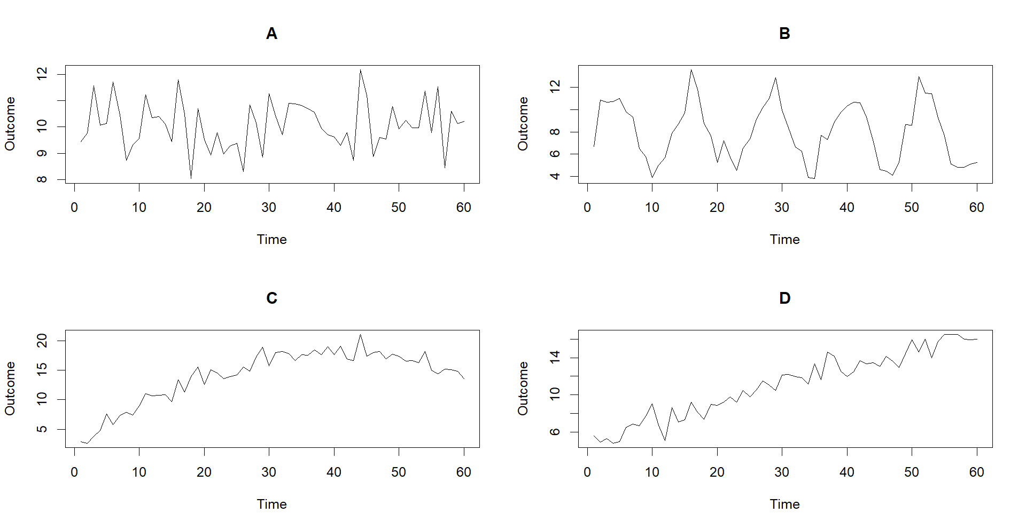

Which model should we use to fit the data?
outcome_{t} =β₀+ε_{t}
outcome_{t} =β₀+ β₁·time+ε_{t}
outcome_{t} =β₀+ β₁·time+β₂·time²+ε_{t}
outcome_{t} =β₀+β₁·sin(2$π$t/12)+ β₂·cos(2$π$t/12)+ ε_{t}

Slide 11
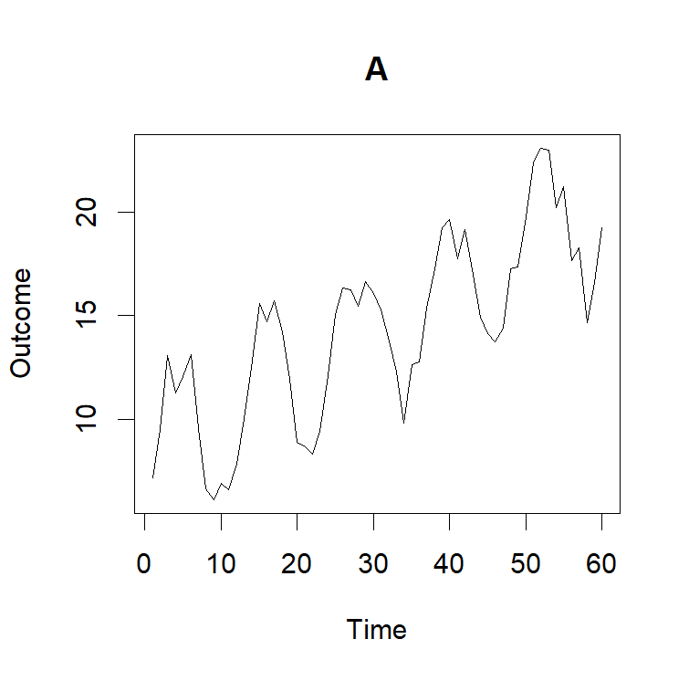
What model would you use for this data?

Slide 12
Syndromic surveillance

Slide 13
Research questions with time series data
Describe the behavior of an indicator over time
Is infant mortality decreasing over time? By how much?
What are the seasonal differences in malaria cases?
Detect deviations from expected in an indicator
Is a region experiencing higher than expected cases of diarrhea?
Is the number of health facility deliveries lower than expected?
Measure the impact of an intervention on an indicator
After social distancing measures were put in place, how many fewer COVID-19 cases were there?
Notes:
What have we done so far?

Slide 14
Detecting deviations from expected
Syndromic surveillance: is the process of monitoring data on symptoms or outcomes related to a disease as a way to detect areas that might be affected by the disease.
Pros:
Provide “warnings” for local areas.
Uses existing data.
Process can be automated.
Cons:
Not as good as monitoring the disease directly.
Changes could be explained by other factors that should be considered.
Notes:
QUESTION: What are some “Other factors” that should be considered?

Slide 15
How to conduct syndromic surveillance
Step 1. Choose relevant indicators to follow over time (Session 1) and format data for analysis (Session 4)
Step 2. Determine baseline and evaluation periods
Step 3. Fit time series model to baseline period (Sessions 2 & 3)
Step 4. Using the model from Step 3, calculate deviations from expected in the evaluation period (Session 3)
Step 5. Produce interpretable visualizations (Session 4)

Slide 16
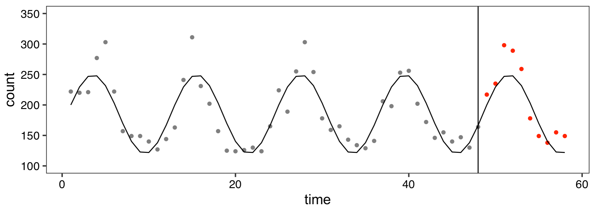
Group activity: how should we calculate deviations from expected?

Slide 17
Group activity: how should we calculate deviations from expected?
Are the number of malaria cases higher or lower than expected in January 2020? By how many malaria cases?
In the evaluation period, are the observed numbers of malaria cases systematically higher than expected, lower than expected, or is there no discernable pattern?
Does using predicted cases - observed cases to identify deviations make sense? How could this measure be improved?
Your group should answer these questions on a Google Form in a Breakout Room.
Notes:
https://docs.google.com/document/d/1n8NZmXi12ud3Tq3XwukmNPi-yvOaJGAb4Xc4hy9yAtk/edit?usp=sharing
https://docs.google.com/document/d/1i3niCRspaYgCFyZv4FedHjm_qgTudJTf4JFzv2qPIFM/edit?usp=sharing
https://docs.google.com/document/d/1SnbNNXhEPTjM_WFsJGb4PKfKYwMf44laHU5ic4cyec4/edit?usp=sharing
https://docs.google.com/document/d/1BMacpBTOfr9AEuDAePF_fRnLcrLjUgW9sbjulRaNRWo/edit?usp=sharing
https://docs.google.com/document/d/1Mt0tlsT_VXwZyOOjUNcs34OBCBfgehutNO45ZnnlMTA/edit?usp=sharing
https://docs.google.com/document/d/1g9GR6NagLkLczVDEIxIeCLw1wB_QpshNcQmFzXU_3wg/edit?usp=sharing

Slide 18
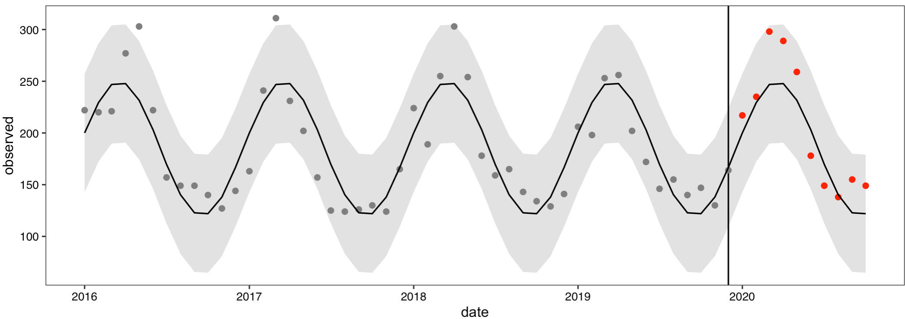
Prediction intervals
Prediction interval: the range of values where a future individual observation (monthly count) is likely to fall.
Prediction intervals are different than confidence intervals, because they correspond to an individual value, not the mean.

Slide 19
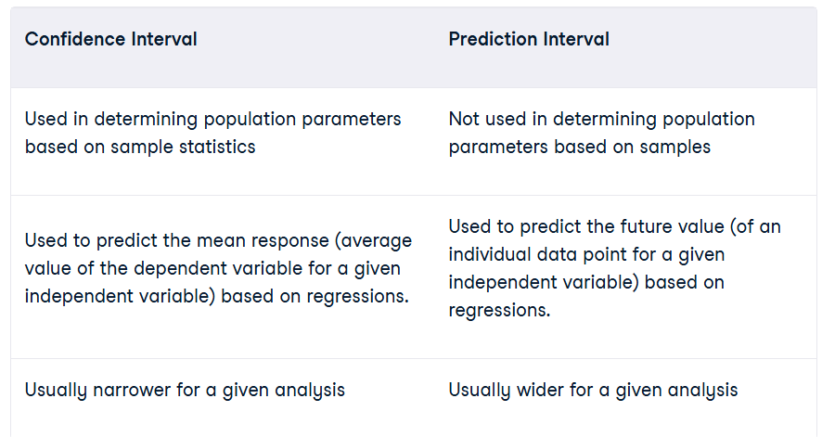
Confidence vs. Prediction intervals

Slide 20
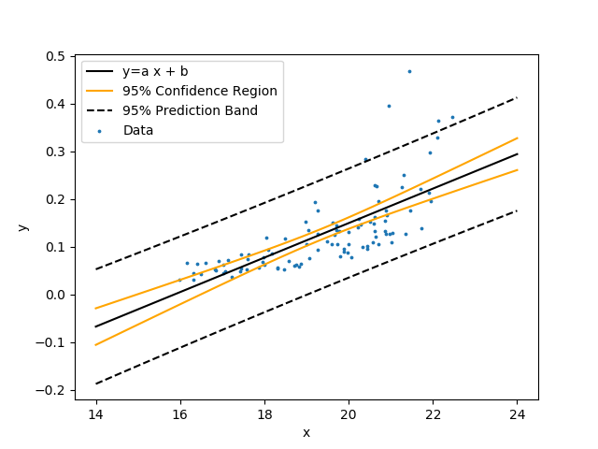
Confidence vs. Prediction intervals
For the model outcome_{t} =β₀+ε_{t}
Confidence interval: Uses just the estimate of β₀
Prediction interval: Uses the estimate of β₀ and ε_{t}

Slide 21
Syndromic Surveillance Training Project
Goal: Integrate skills learned in this training to a real dataset.
Task: Using the provided dataset, you will define a research question, examine the data, clean the data, run an analysis, and plot the results. You will work in teams of 1-3.
Product: A 10 minute presentation on Friday of your work. This should include:
Research question
Data description
Methods
Results and figures
Conclusion

Slide 22
Syndromic Surveillance Training Project
Example Project:
Question: Using HMIS indicators for births, do we see any change in 2024 from the previous years?
Dataset: HMIS births from 2020-2024.
Analysis: Fit a trend+seasonal model on birth data from 2020-2023. Predict into 2024. Compare predictions with observed.
Results: Plot the predicted vs. observed. Compute the differences between the two.

Slide 23
Review: Confidence vs. Prediction intervals
Why is a prediction interval generally wider than a confidence interval?
How does changing the confidence level (e.g., from 95% to 99%) affect both types of intervals?
If trying to find the interval so that you are 90% sure a new observation will fall within, which interval do you use?

Slide 24
Next lecture: Cleaning the Data
Extracting data
Setting up data in usable format
Identifying outliers
Dealing with missing data
Automation

